Slide 1
Lucia Fojtíková
and Kristián Csicsay

Slide 2
Seismic events on the territory of Slovakia (1034-2015)
1906 Ms=5.7

Slide 3
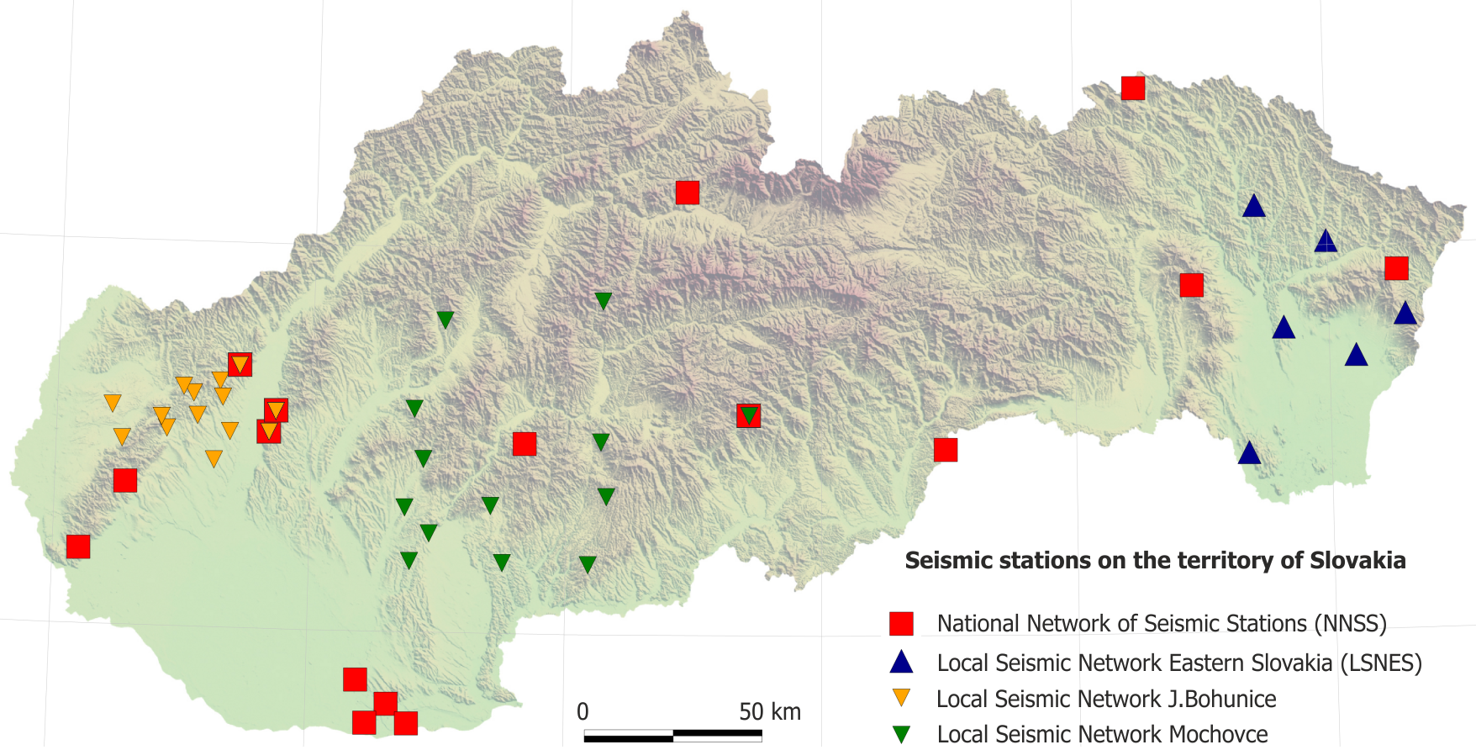
Seismic stations on the territory of Slovakia
Problems
lack of people – we are terrible missing an electro-technician
lack of money – our bosses do not understand what we need

Slide 4
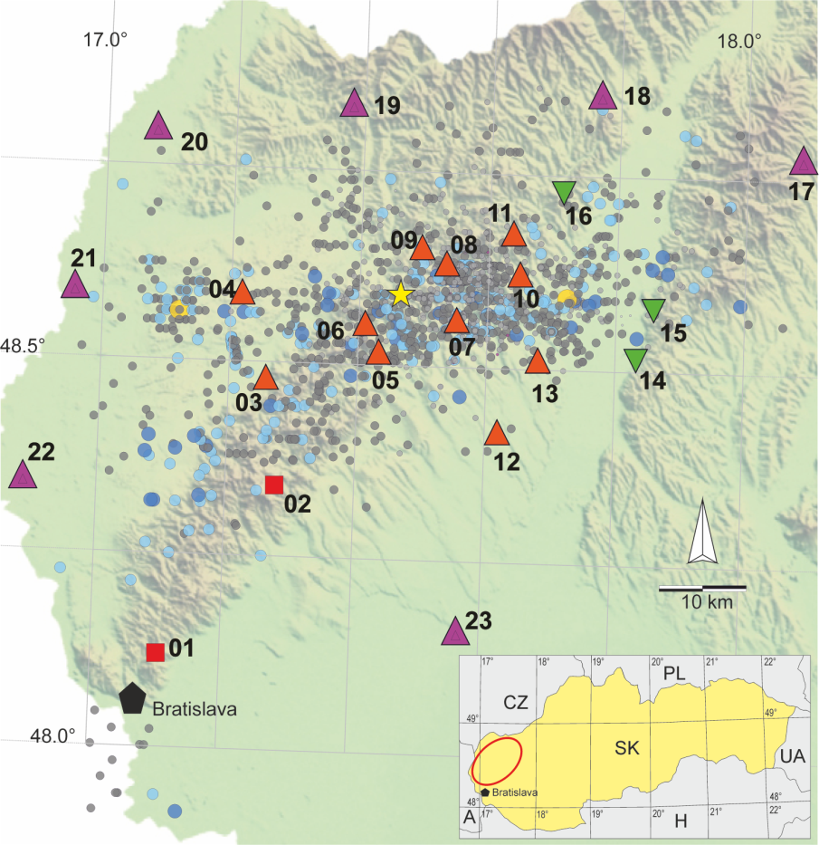
Plans

